Slide 1
First Session
John Doe

Slide 2
A tiny little bit of economic history

Slide 3
Our goal:
quickly contextualize the content of the course
contrast classical and keynesian thinking

Slide 4
Say something

Slide 5
The Classical

Slide 6
Adam Smith | David Ricardo | Malthus | Jean-Baptise Say
Adam Smith | David Ricardo | Malthus | Jean-Baptiste Say

Slide 7
The Classical Economists
Capitalism -> Market
Classical: understand how market forces solve societies problems
Market is the best way to allocate resources: production decisions and allocations of goods

Slide 8
The Classical Economists
How do markets operate?
What determines value
utility?
cost?

Slide 9
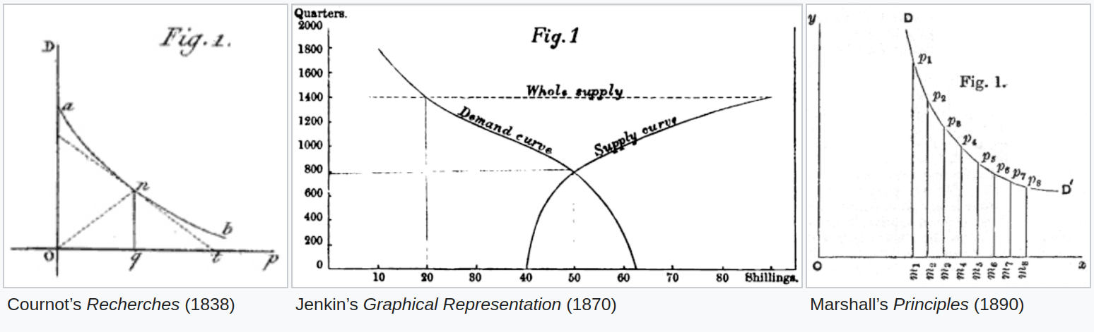
Classical Questions
What determines prices?
supply/demand : market equilibrium
. . .

Slide 10
The Classical View
Implications:
what should the government do?
nothing
or … fix the market
markets will eventually adjust

Slide 11
Role-Play : you are a Classical Economist
Here is the situation:
You are the king: what should you do?

Slide 12
The Classical Economists on the Aggregate Economy
prices are irrelevant
crises are temporary deviations from equilibrium
sectorial issues with particulat markets

Slide 13
The law of Markets : Say’s law
Supply creates its own demand
. . .
more precisely: It is worthwhile to remark that a product is no sooner created than it, from that instant, affords a market for other products to the full extent of its own value.
. . .
quoted by Keynes as: “From the time of Say and Ricardo the classical economists have taught that supply creates its own demand…”
. . . even more precisely: There cannot be a shortage of demand.
Notes:
You can start by supply creates its own demand, then pretend you heard the ghost of JB Say who is not happy with what you said and ask you to clarify

Slide 14
Modern version
Recall the circular graph for GDP:
Revenue = Income

Slide 15
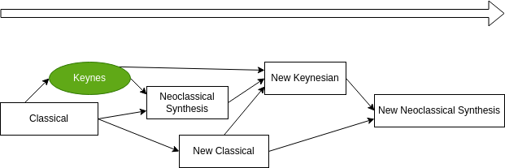
Keynes

Slide 16
Keynes | The General Theory of Employment, Interest and Money

Slide 17
Someone has a bad dream

Slide 18
The factory manager has a bad dream

Slide 19
Constant prices

Slide 20
Keynesian economics
government intervention

Slide 21
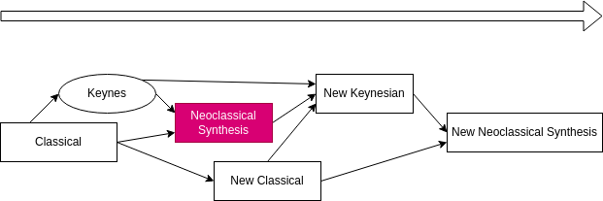
Neoclassical Synthesis

Slide 22
Adam Smith | David Ricardo | Malthus | Jean-Baptise Say
Hicks | Samuelson | Malthus | Jean-Baptiste Say

Slide 23
The program of the neoclassical synthesis
Describe a rigorous, quantitative framework, to expose both classical and keynesian ideas
Consensus:
long term is classical
short term is keynesian
keynesian cross, IS-LM

Slide 24
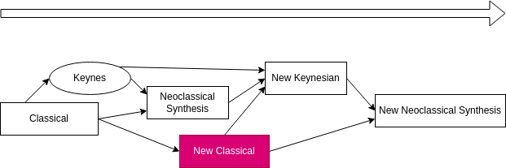
New Classical

Slide 25
Adam Smith | David Ricardo | Malthus | Jean-Baptise Say
Hicks | Samuelson | Malthus | Jean-Baptiste Say

Slide 26
New Classical
Microfoundations:
mathematical foundations assuming each agent is rational…
…like in microeconomics
Side effect: to be perfectly rational, individuals must form “rational expectations”
and that isn’t compatible with keynesian “behavioural assumptions”, especially the notion of “involuntary employment”
which imply some systematic mistakes
Why are there fluctuations if agents are fully rational?
there can be changes in productivity
real business cycles: rational expectations model driven by productivity shocks
so, you see, no need for keynesian ideas
Example: the Lucas Critique

Slide 27
New Keynesian

Slide 28
Adam Smith | David Ricardo | Malthus | Jean-Baptise Say
Blanchard | Gali | … | … Say

Slide 29
New Keynesian
Reuse tools from the new classical framework
agents optimisation
rational expectations
Add market imperfections (on the supply side)
monopolistic competition
price rigidities
-> To show that demand policies can have an effect in the short term

Slide 30
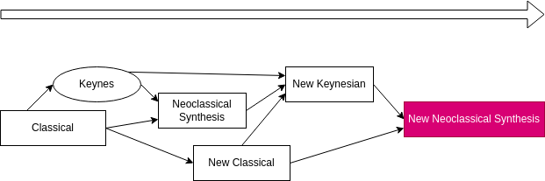
New synthesis

Slide 31
Most macroeconomists now use tools from the new synthesis

Slide 32
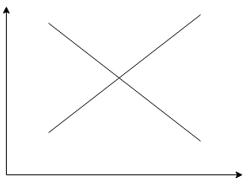
The new-keynesian model
Short-term graphical version:
Fully-fledged model
Aggregate Demand (AD)
Investment-Saving
Aggregate Supply (AS): $y_{t}=y_{t+1}+...$
Sometimes referred to as the IS-MP variant of AS-AD
Note that AD/AS have their own stories to tell

Slide 33
Plan for the Course
Session 1: start again on slide 1 and stop when you have understood the joke
Session 2: aggregate demand
Session 3: aggregate supply
Session 4: macroeconomic fluctuations
Session 5: monetary policy
Session 6: unconventional monetary policies

